Slide 1

Welcome to Our Today’s Presentation Based On HTML+CSS and SQL.

Slide 2

Our Project
HOSPITAL WEBSITE

Slide 3


Group Members
ABHISHEK SINGH
RITIK ATHILKAR
RAJAT KALOTRA
M.T.H.ALVEE
WE THE TEAM MEMEBERS ARE PUTTING FORWARD OUR PROJECT WHICH IS BASED ON THE IDEA OF HOSPITAL WEBSITE.

Slide 4
INTRODUCTION :
Hospital website with help of HTML+CSS+SQL+PHP

Slide 5
ACKNOWLEDGEMENT
FOR PROJECT
I would like express my special thanks of gratitude to my teacher (Milanjit Mam and Ranjit Sir) who gave us the opportunity to work on this wonderful project “HOSPITAL WEBSITE” based on HTML+CSS+SQL. Secondly I would like to thank my group members who helped to complete this project within limited time frame.

Slide 6

Making a Hospital Website :
List of laungages/softwares used:
VS Code
XAMPP
HTML+CSS
SQL
Phpmyadmin(Localhost)
JavaScript

Slide 7

Advantages of our project :-
This system helps in lowering manual work done by the patients to get appointments of doctors in a single click.
It helps in keeping the patients updated about the availability of doctors.
It has become easy to get information through websites.
We can choose doctor of our choice and we can consult to our doctor online.

Slide 8

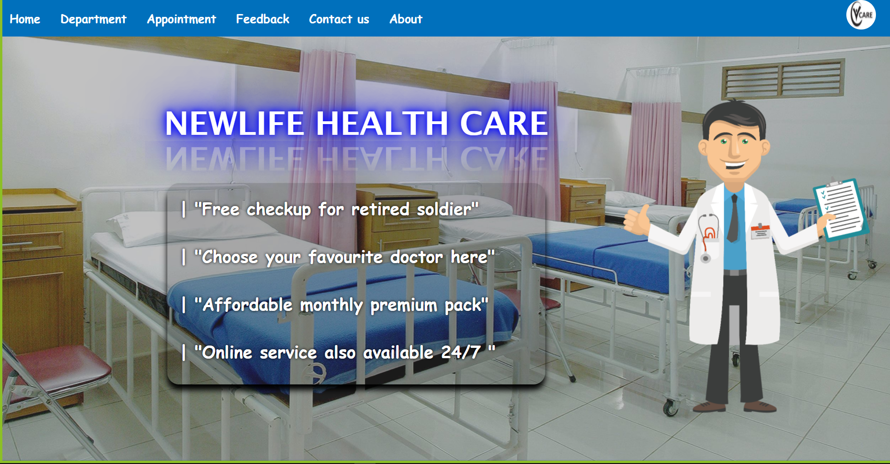
HOMEPAGE

Slide 9
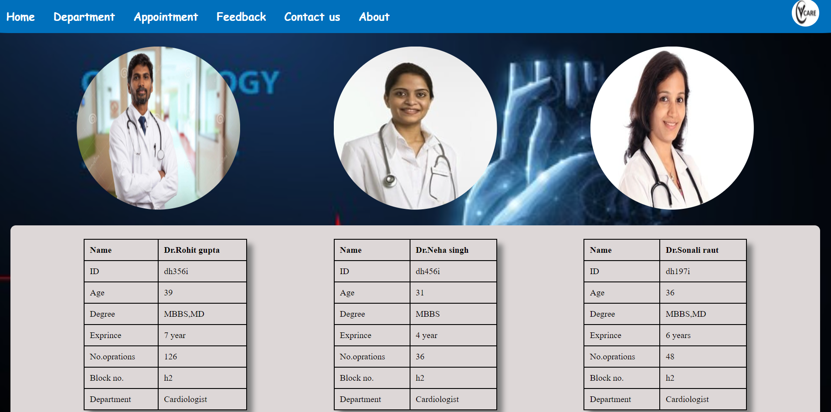
DEPARTMENT

Slide 10
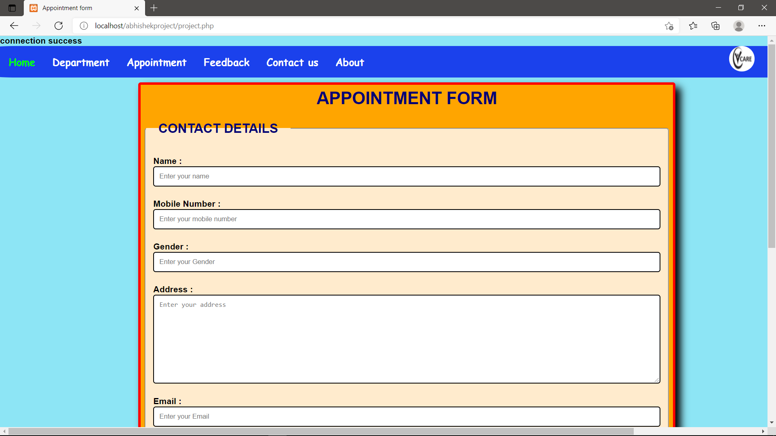
APPOINTMENT

Slide 11
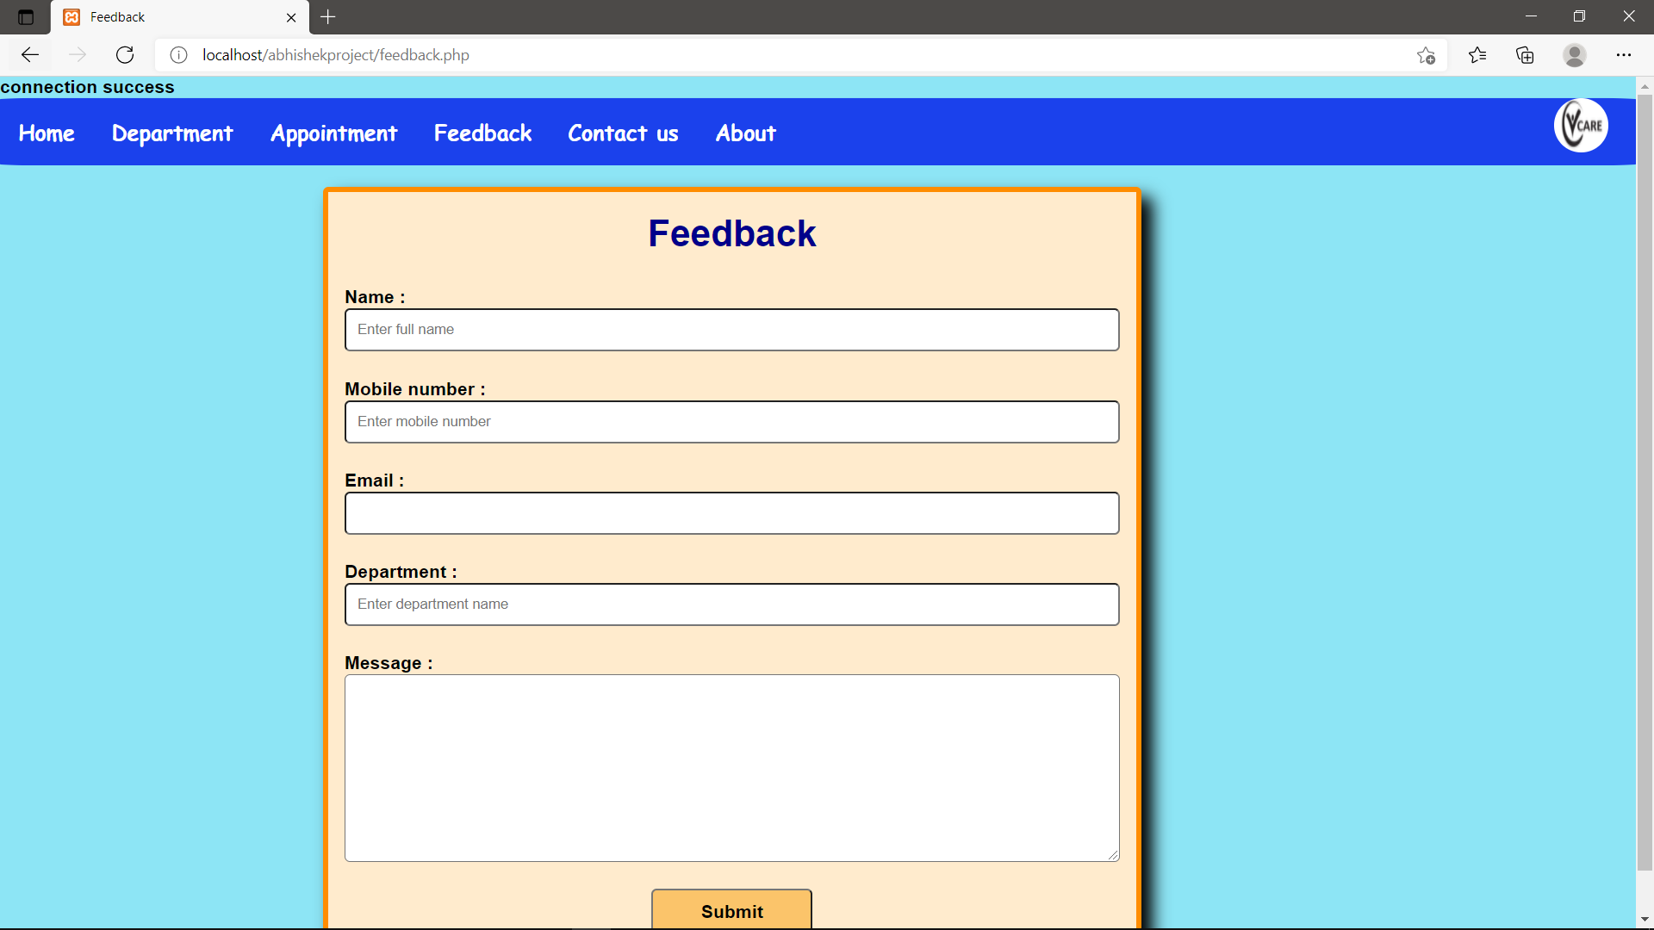
FEEDBACK

Slide 12

CONTACT US

Slide 13
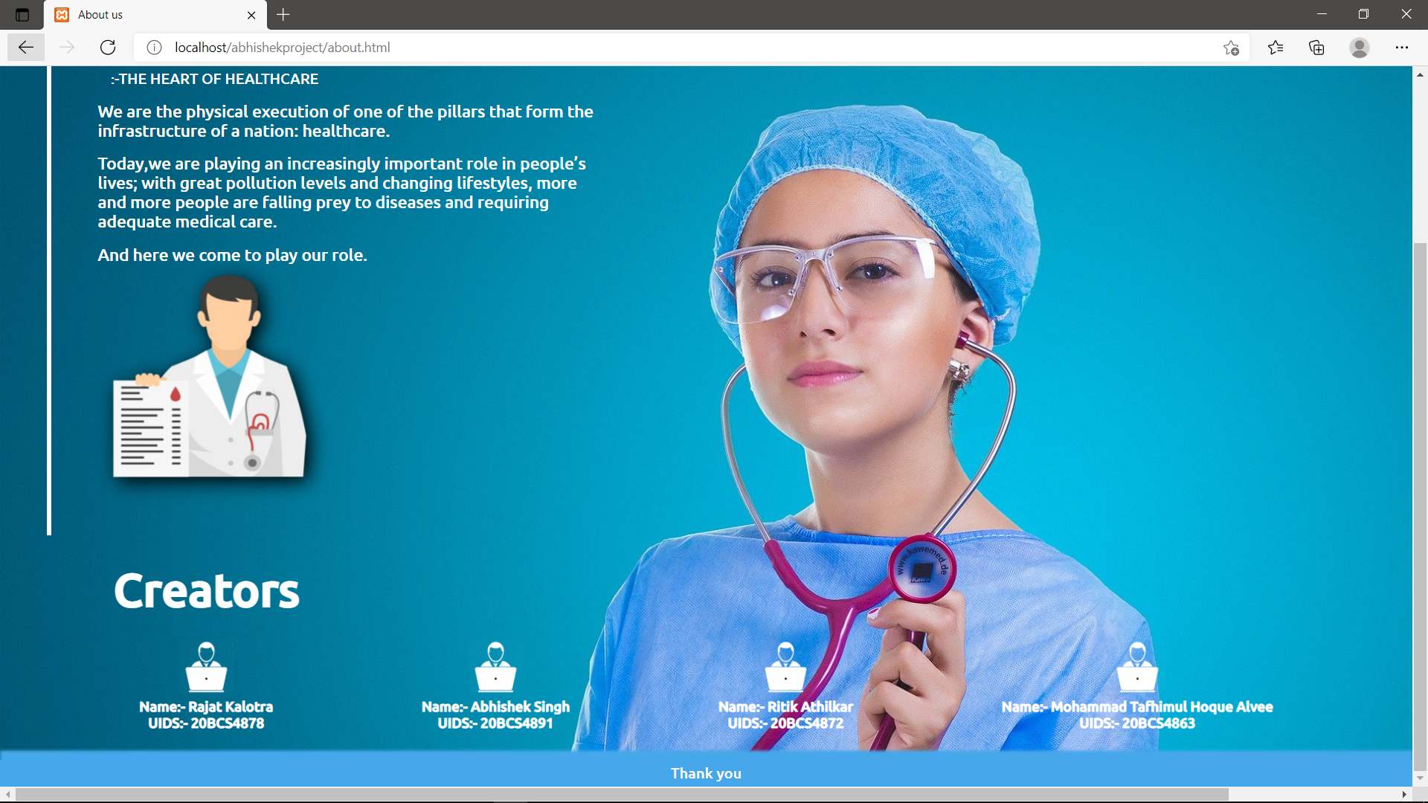
ABOUT US

Slide 14
CONCLUSION
We have made a hospital website in which we can take appointment online , consult doctor on phone etc. Time will be given to the patient and will receive callback with respect to given time.

Slide 15

Thanks for Listening with great patience.

Slide 16
GROUP MEMBERS
NAME: UID:
ABHISHEK SINGH ----- 20BCS4891
RITIK ATHILKAR ----- 20BCS4872
RAJAT KALOTRA ----- 20BCS4878
MOHD. ALVEE ----- 20BCS4863

